Slide 1
Personal Portfolio

Slide 2
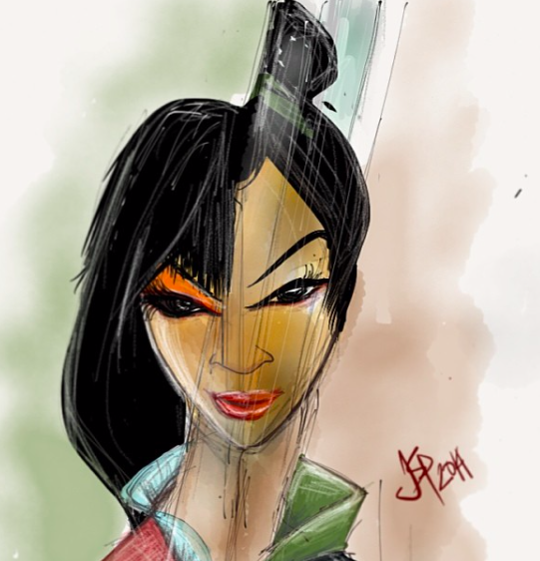
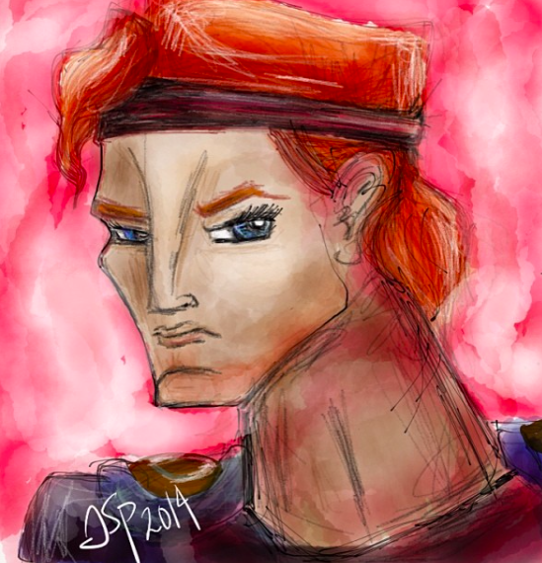

Slide 3

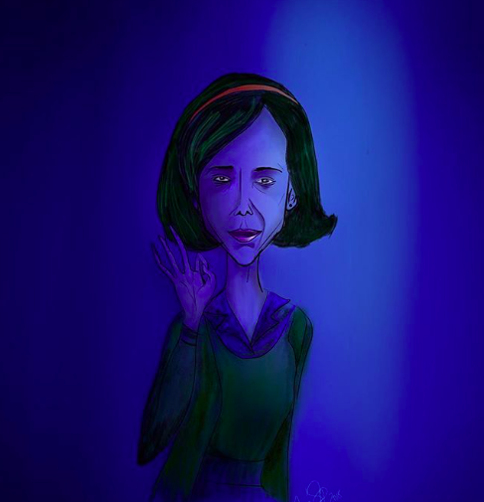

Slide 4
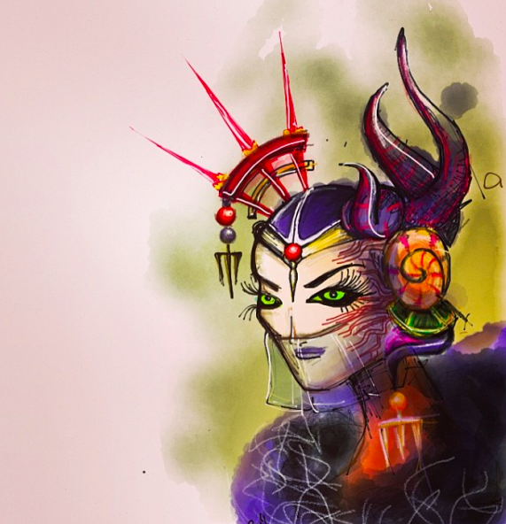
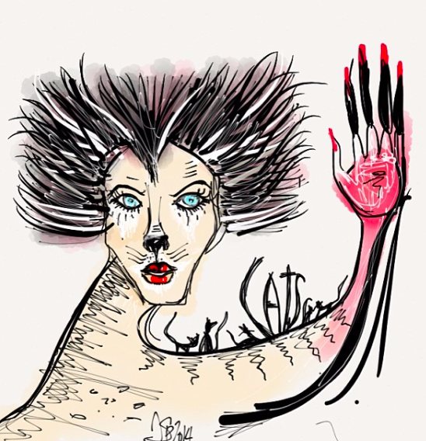

Slide 5
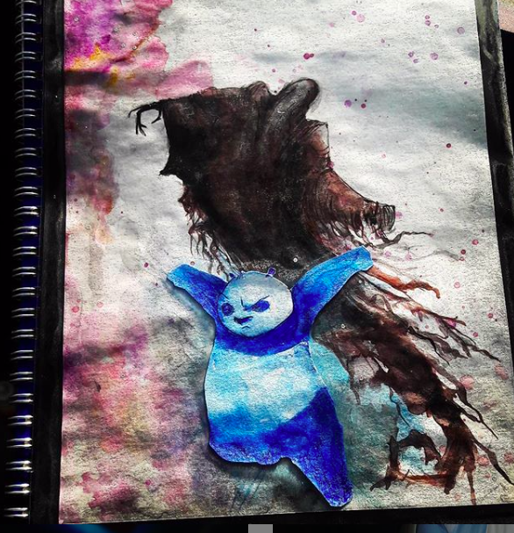


Slide 6
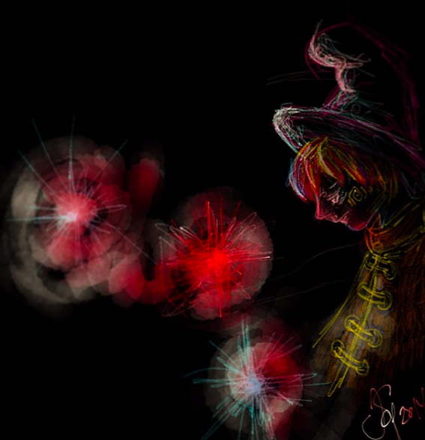


Slide 7
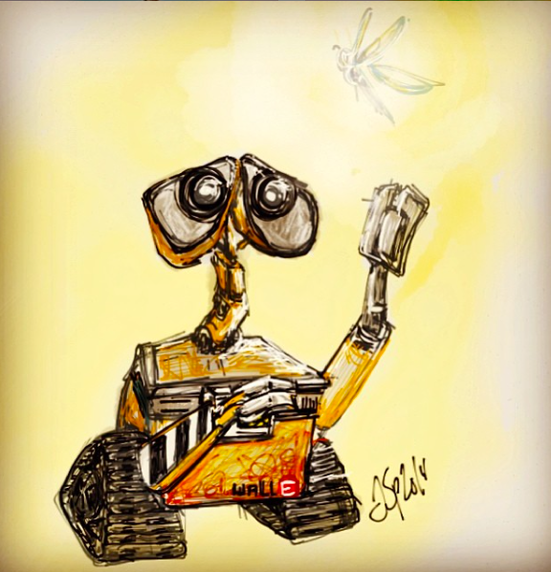
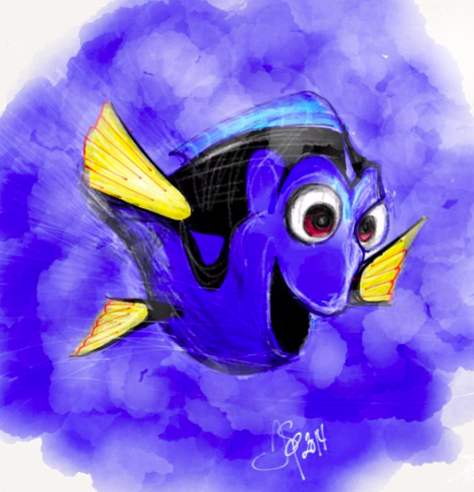

Slide 8

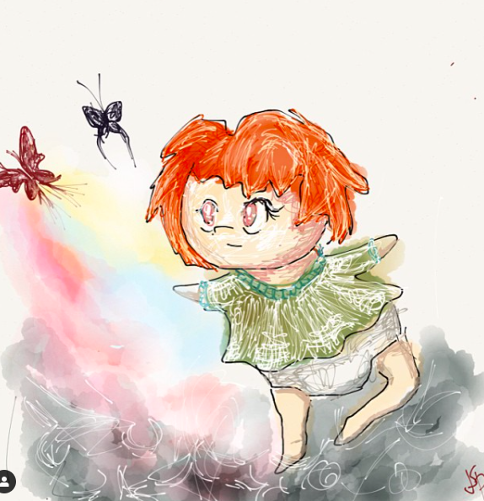

Slide 9

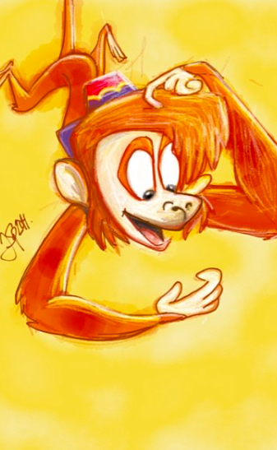
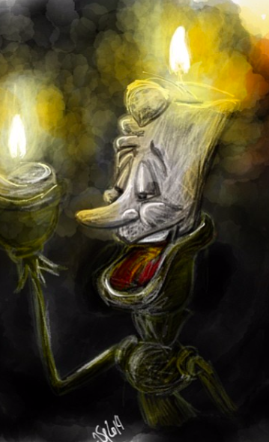

Slide 10


Final Project Flutter
Jose Sanchez Parra
Sanchj9 (400282044)

Slide 11

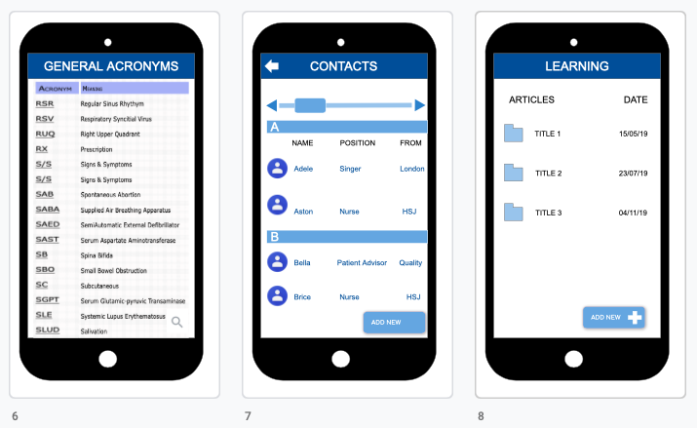
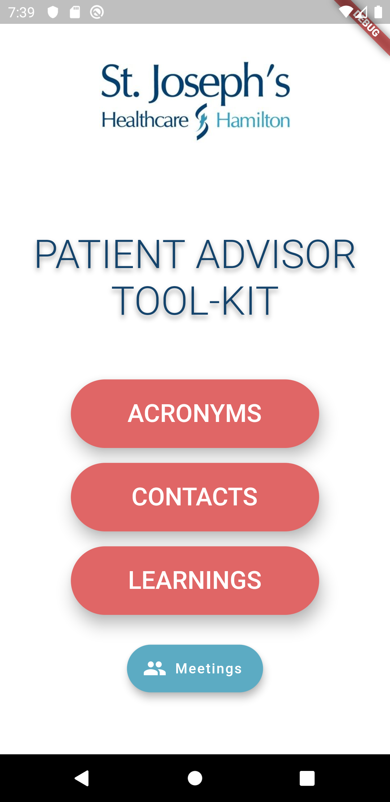
In the first screen we set the four relevant sections:
acronyms
meetings
contacts
learnings

Slide 12
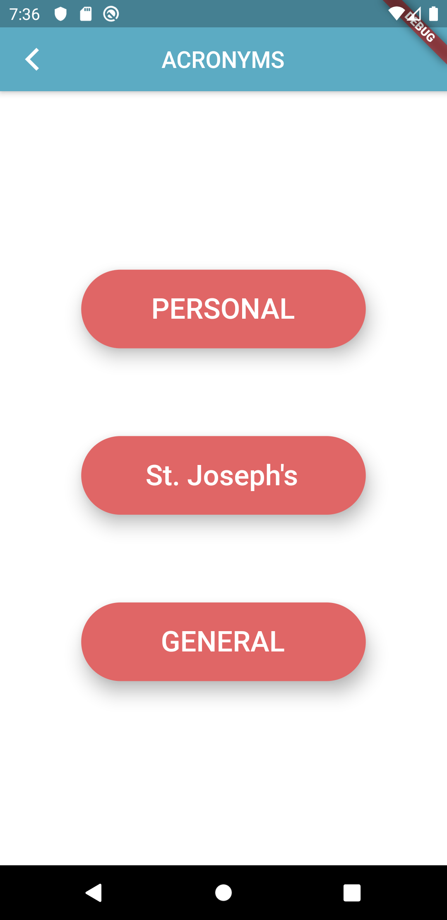
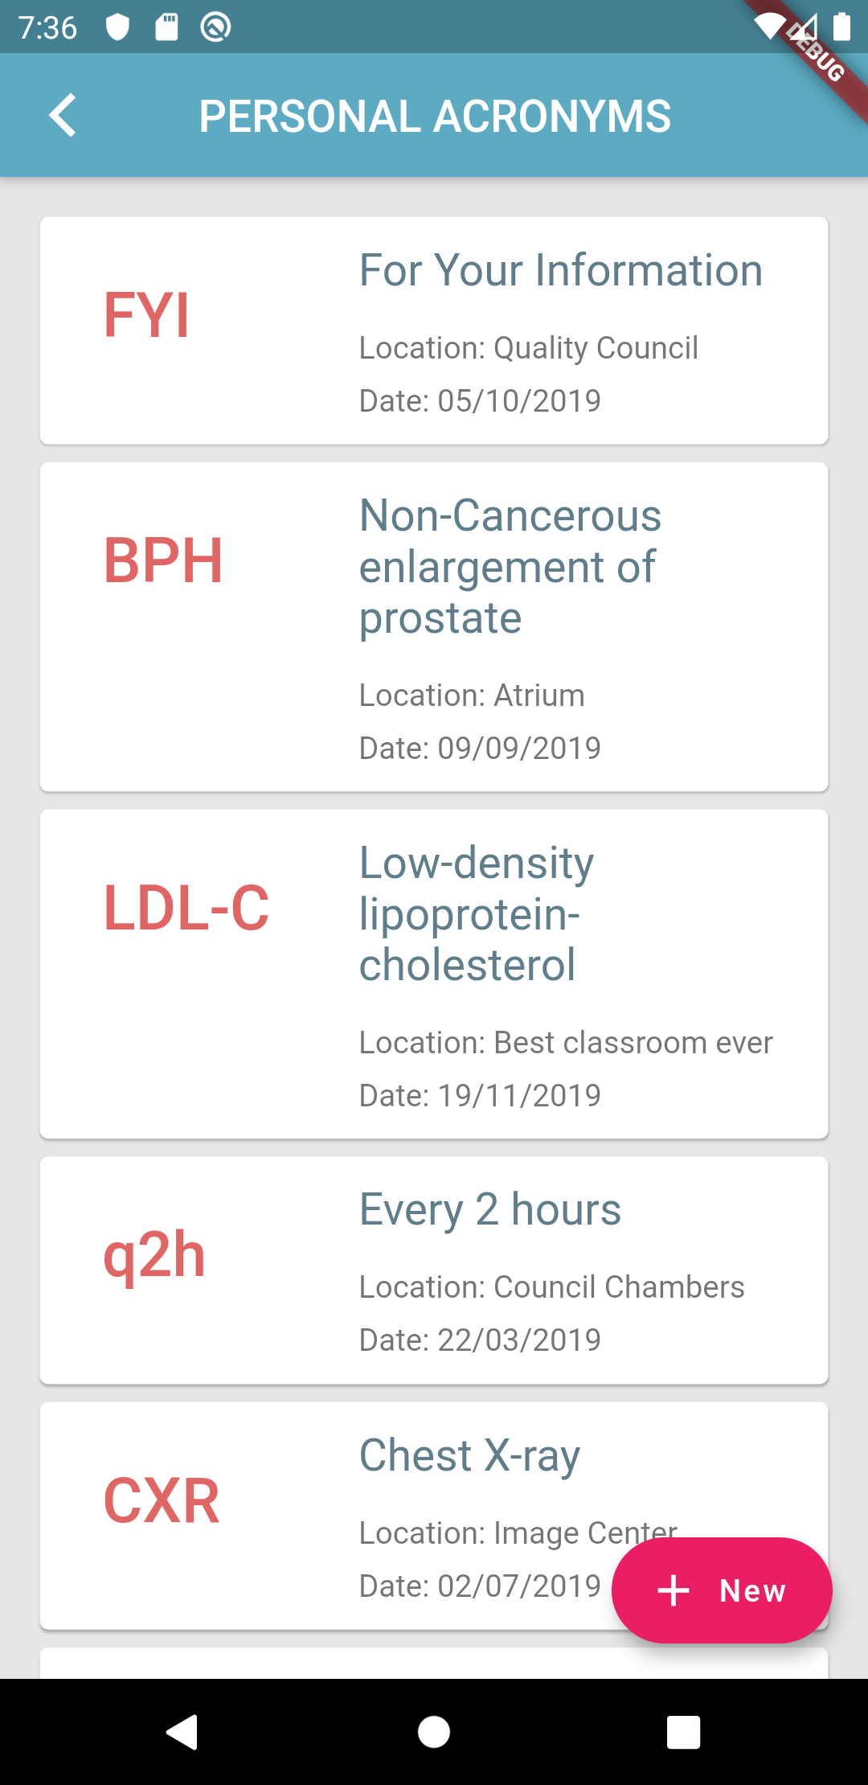
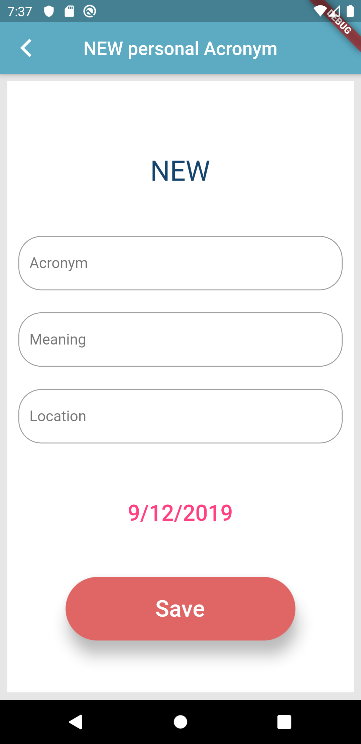
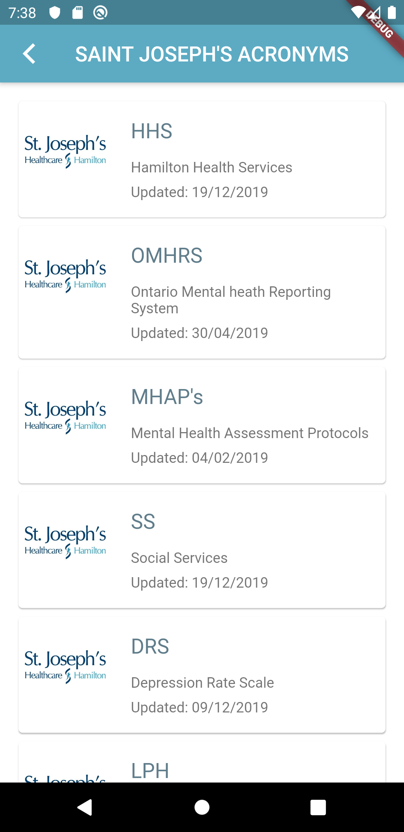
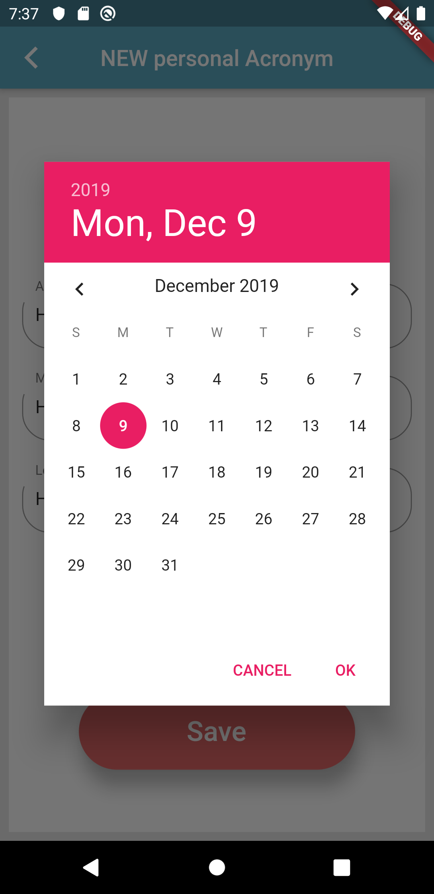
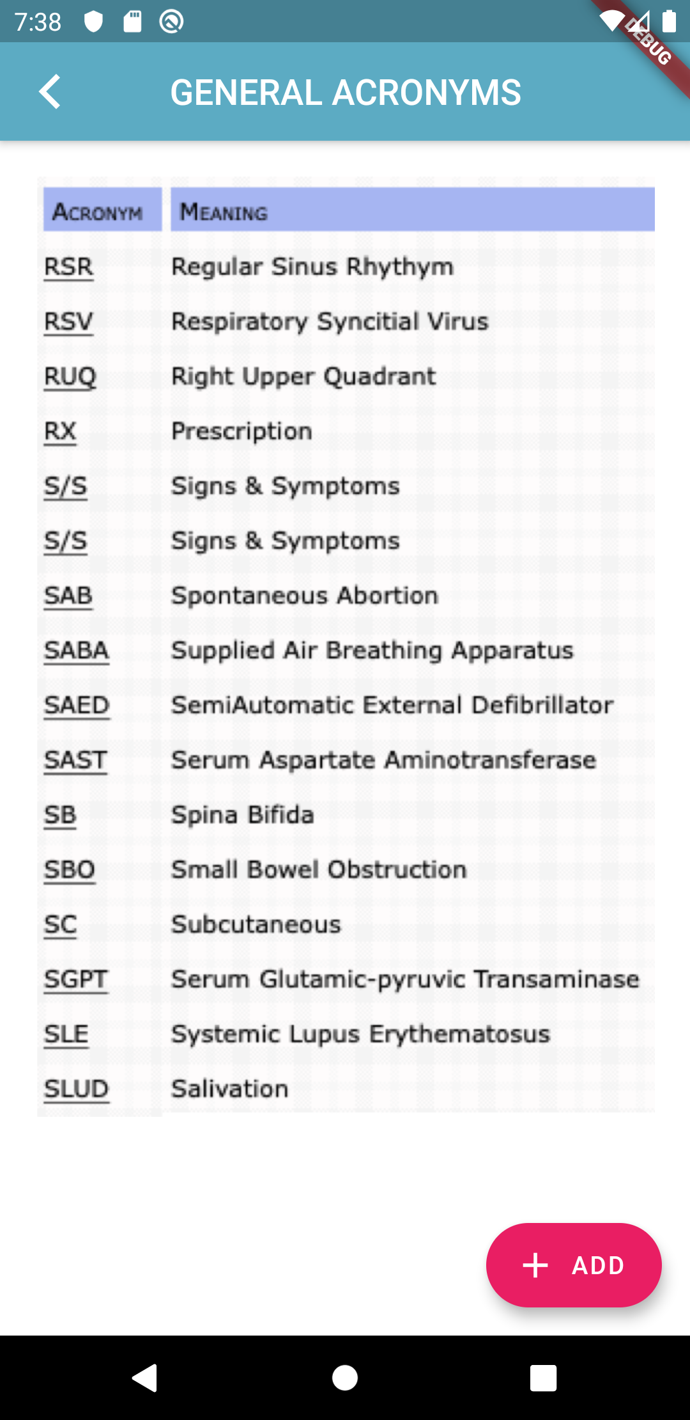
In the ACRONYMS section we included three categories:
Personal acronyms the most important section of the app where the acronym were showed and have the meaning, the location and the date when was recorded, this information is store in Firebase.
St Joseph’s hospital is a list of specific acronyms of the hospital and should be handled by health staff directly on firebase .
The GENERAL Its just conceptual, not already working

Slide 13
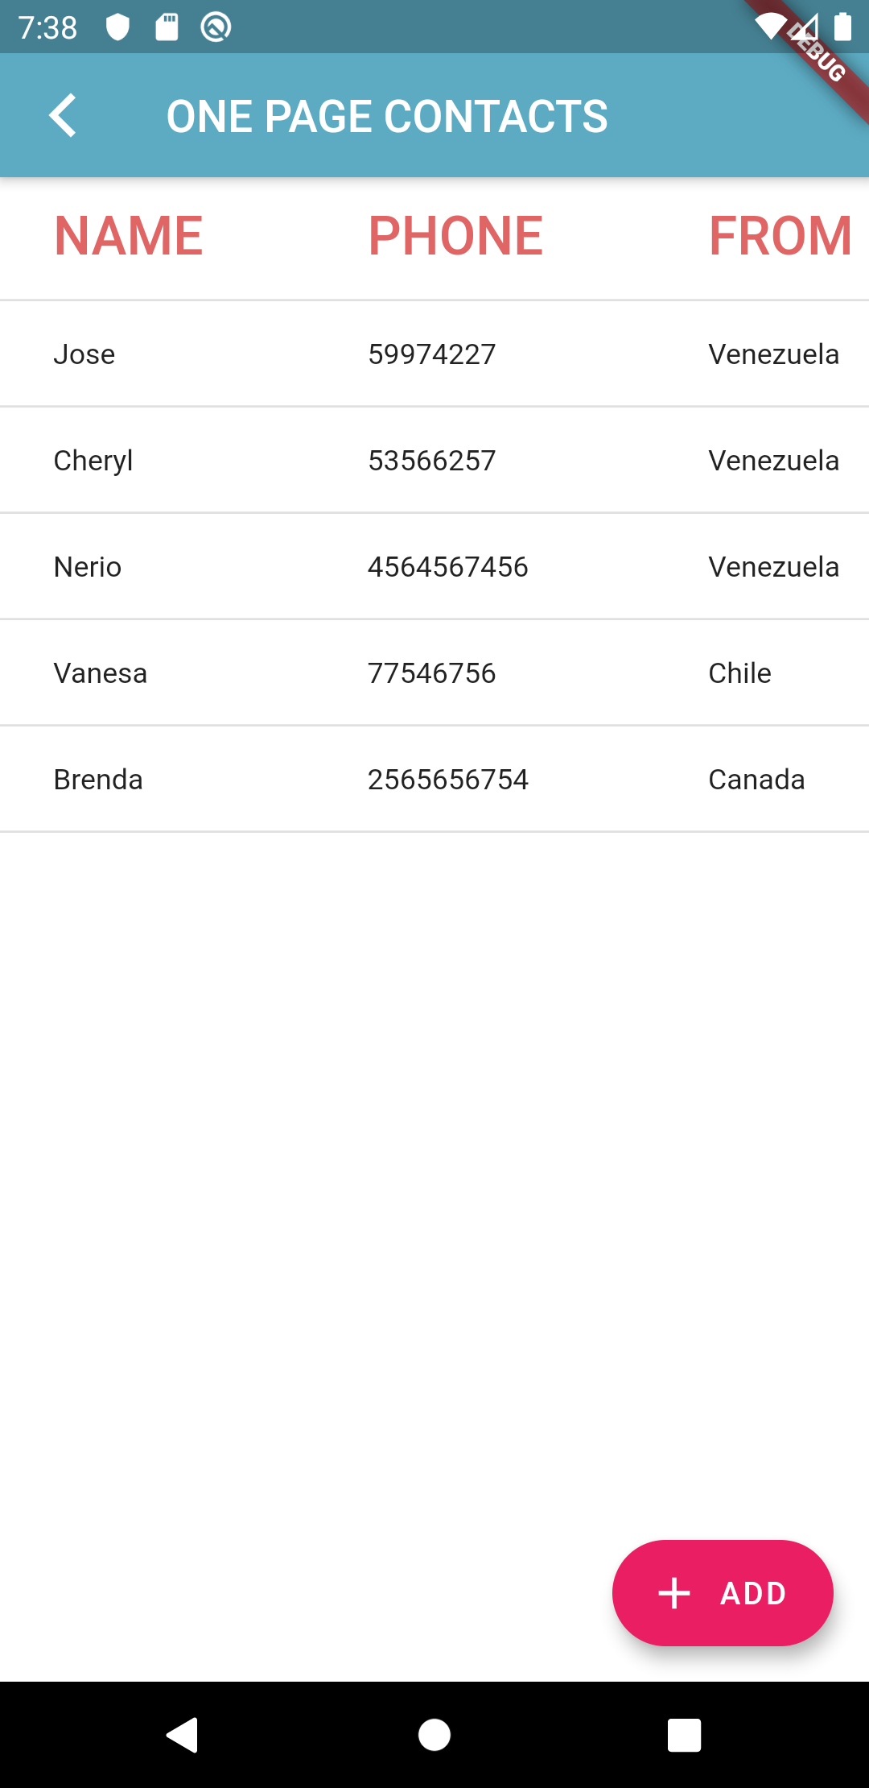
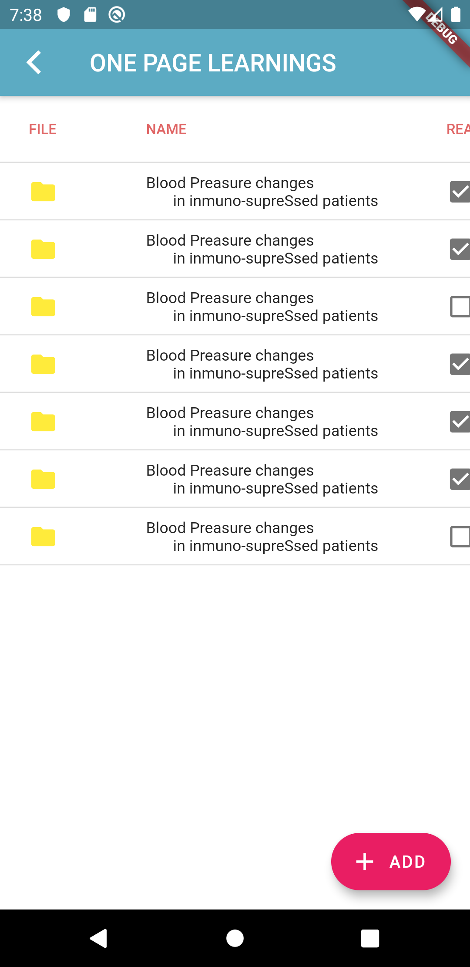
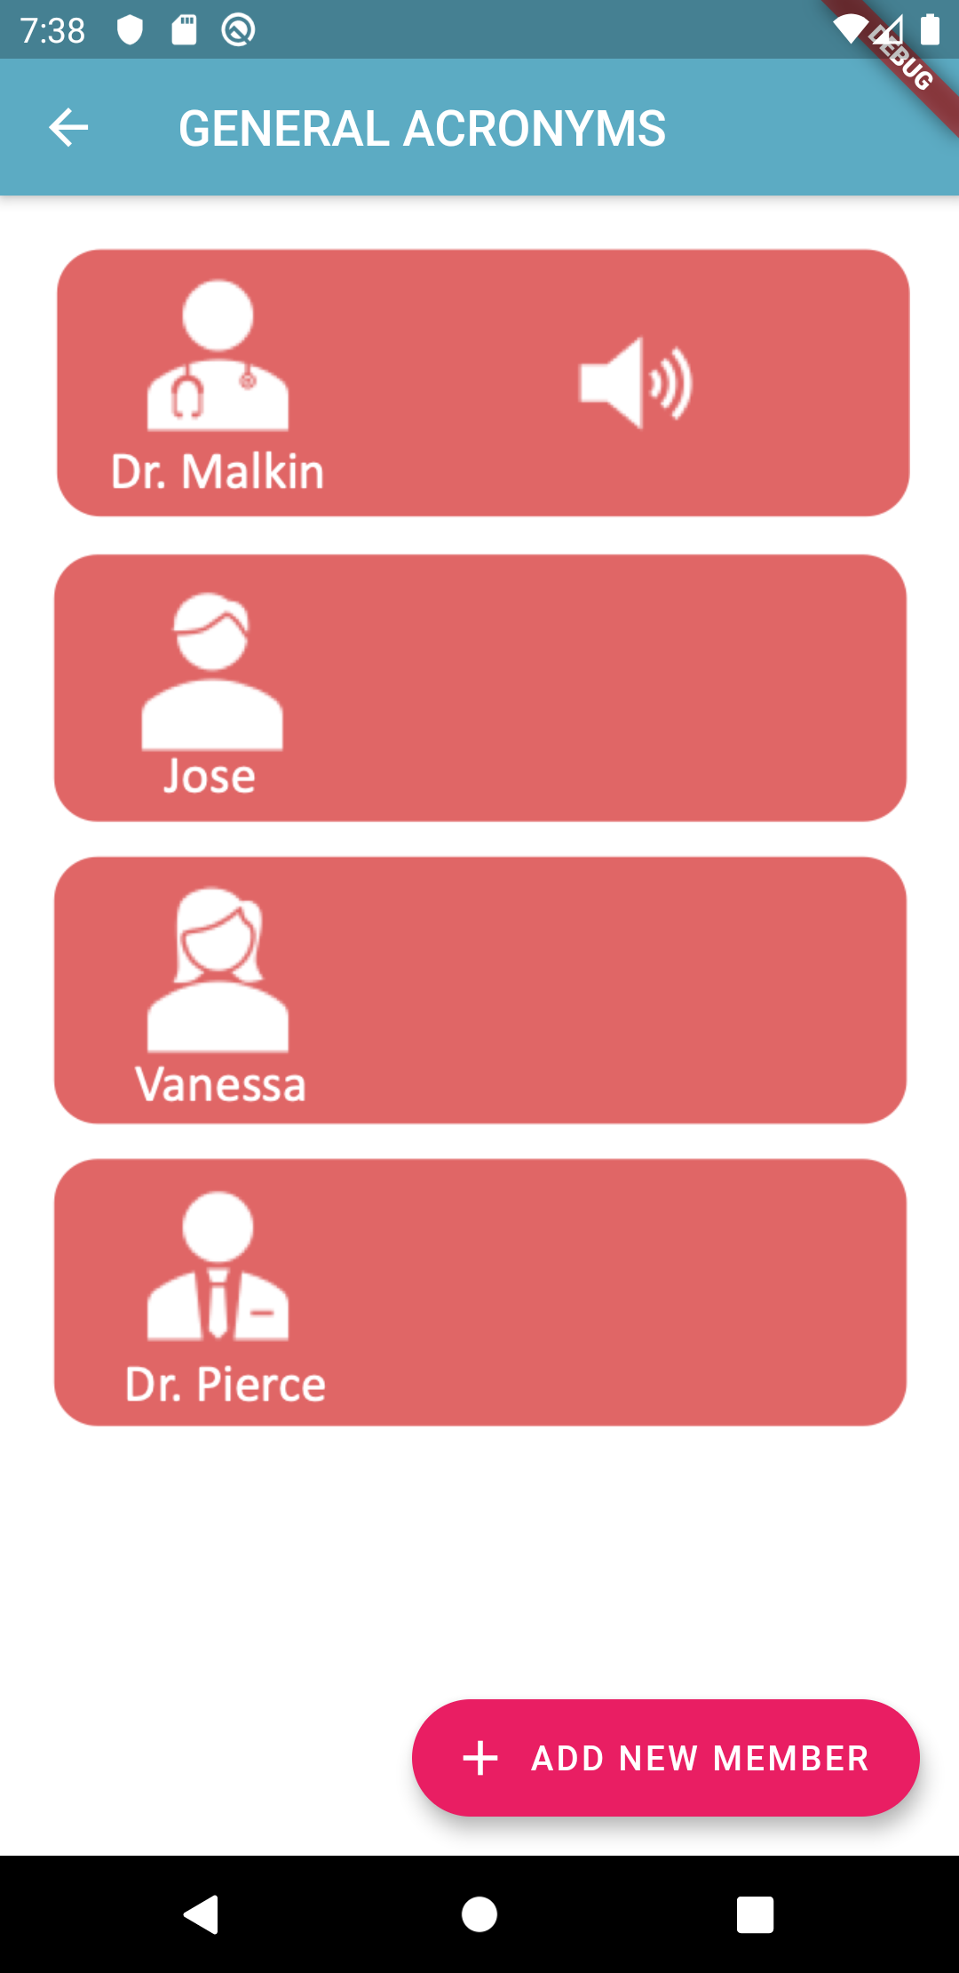
This tree screens are to complete the requirements of low fidelity prototype of my Design Thinking Project, are not interactive
The contacts section of the app consists of a scrollable and consolidated table with all the contact information of the medical staff, in order to facilitate on a single page the vision of association of each contact.
The learning section, the purpose of this was to have a kind of digital file cabinet to store all the official information related to their position as PA, and tracking of the progress of their onboarding process (Conceptual)
The Meeting section its just a prototype picture

